Slide 1

Centre For Development Of
Advanced Computing, Mohali
Project On
EDUCATION APPLICATION SYSTEM
Presented by -
Project Co-Ordinator
Abhiraj Vikas Gautam
Sumit Kumar Giri
Er. Sumandeep Singh
Project Engineer

Slide 2


CONTENTS
Introduction of Project.
Objective.
Feature & Scope.
Introduction of .NET .
Introduction of Angular.
Introduction of MySQL.
2

Slide 3

INTRODUCTION
In the modern world of technology computers are affecting our lives in more ways than we probably are aware of COMPUTERISED MANAGEMENT, maintaining information of an educational institutes, Colleges, other the list is endless.
This project specified all working that taken by a College Manager.
If manager want necessary information he checks the information about a student, staff, worker etc.
It is difficult to prepare the manual work to store the information about the all students, teachers as well as about workers.
So this project helps to store those type of information using computerized system.
Some Modules of college management.
Student Information & Student details.
Staff Information & Staff details.
3

Slide 4

OBJECTIVE
The objective of this project is to develop a GUI based Software i.e. platform independent, user friendly etc.
Streamline administrative tasks such as all record-keeping.
Enhance communication and collaboration between faculty, staff and students.
Automate routine processes to improve efficiency and reduce manual errors.
Provide a centralized platform for managing student information, academic records and financial data.
Improve accessibility and transparency of information for stakeholders.
4

Slide 5
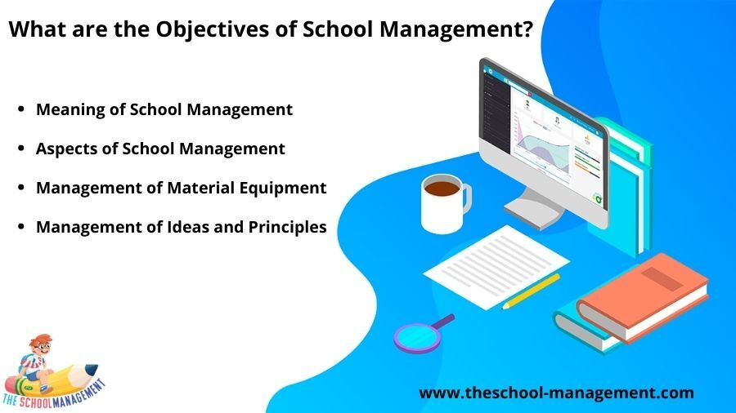
FEATURES & SCOPE
Student Information Management.
Academic Management.
Communication and Collaboration.
Attendance Monitoring.
Centralized platform for data management and communication.
Tailored features for administrators, faculty, students, and stakeholders.
Scalability and customization.
Integration with external systems.
Compliance with data security and privacy regulations.
Continuous support, maintenance, and updates.
5

Slide 6
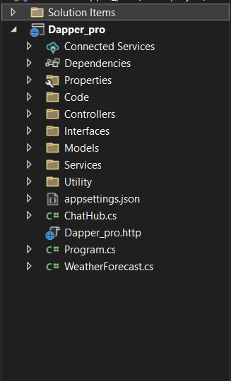
INTRODUCTION OF .NET
.NET is a free and open-source software development platform developed by Microsoft. It provides a framework for building various applications, including desktop, web, mobile, gaming applications.
.NET is designed to simplify software development by providing a consistent programming model and a common set of APIs that can be used across different operating systems and devices.
This framework contains a large number of class libraries known as Framework Class Library (FCL). The software programs written in .NET are executed in the execution environment, which is called CLR (Common Language Runtime).
Some Functionality use in .NET
Controllers.
Services.
Interfaces.
Model.
6

Slide 7
CONTROLLER
A controller in ASP.NET MVC is a class having a set of public methods. These public methods of the controller are called action methods. The action methods in MVC application handle the incoming HTTP Requests.
The Controllers in ASP.NET MVC application logically group similar type of actions together. This grouping of actions together allows us to define sets of rules such as routing, caching, and authorization which is going to be applied collectively.
SERVICES
.NET is a powerful framework that allows developers to build a variety of applications, including Windows Services. The creation of Windows Services can be crucial for developing systems that require continuous background processes, such as system monitoring or data processing tasks.
7

Slide 8
INTERFACES
Interfaces are a powerful feature of the .NET Core programming language that allows you to define contracts between different parts of your code. This can help you to write more maintainable, testable, and reusable code.
An interface is a reference type that defines a contract that other types must implement. This contract specifies the members (properties, methods, events, etc.) that the implementing type must provide.
MODeL
A model is a class that contains the business logic of the application. It also used for accessing data from the database. The model class does not handle directly input from the browser.
Models are also refers as objects that are used to implement conceptual logic for the application. A controller interacts with the model, access the data, perform the logic and pass that data to the view.
8

Slide 9
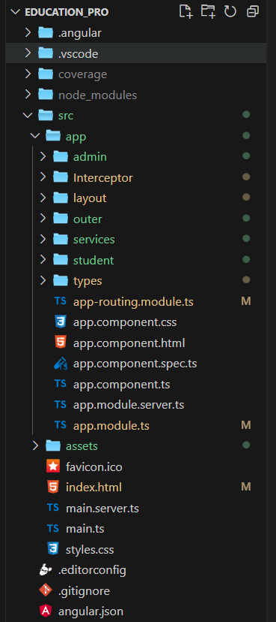
INTRODUCTION OF ANGULAR
Angular is an open-source, JavaScript framework written in TypeScript. Google maintains it, and its primary purpose is to develop single-page applications. Angular is the component base Framework .
Angular is a platform and framework for building single-page client applications using HTML and TypeScript. Angular is written in TypeScript. It implements core and optional functionality as a set of TypeScript libraries that you import into your applications.
Some Functionality use in Angular
Components.
services.
Interceptor.
9

Slide 10
COMPONENTS
The component is the basic building block of Angular. It has a selector, template, style, and other properties, and it specifies the metadata required to process the component.
In Angular, a Component is a piece of code that represents a view. It is responsible for rendering the content and handling user interactions with the view.
SERVICES
Angular services provide a way for you to separate Angular app data and functions that can be used by multiple components in your app. To be used by multiple components, a service must be made injectable.
Services used to provide background functionality not directly related to views such as fetching data.
INTERCEPTOR
HTTP Interceptors are a concept in web development and server-side programming, typically associated with web frameworks and libraries.
They can be used to perform various tasks related to HTTP requests and responses, such as adding headers, handling errors, modifying the request or response data, logging, authentication, etc.
10

Slide 11
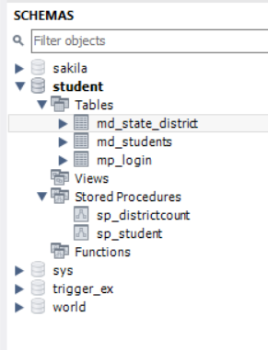
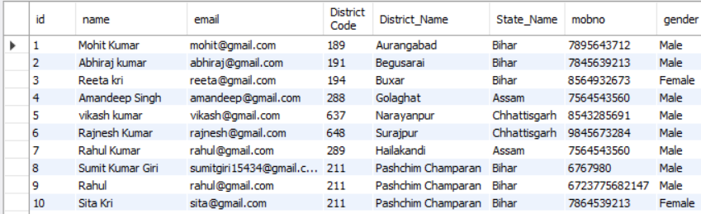
INTRODUCTION OF MYSQL
MySQL is a relational database management system (RDBMS) developed by Oracle that is based on structured query language (SQL).
Its open-source nature, stability, and rich feature set, paired with ongoing development and support from Oracle, have meant that internet-critical organizations such as Facebook, Twitter etc.
STORE PROCEDURE
A stored procedure in SQL is a group of SQL queries that can be saved and reused multiple times. It is very useful as it reduces the need for rewriting SQL queries. It enhances efficiency, reusability, and security in database management.
11

Slide 12


12

